Slide 1


Unit 3
Equipment
Notes:
Welcome to Unit 3 of Module 5.

Slide 2

By the end of this unit, you will be able to:
assess and record data on equipment availability and functionality at various service sites within a health facility
Notes:
By the end of this unit, you will be able to correctly assess and record data on equipment availability and functionality at various service sites within a health facility.

Slide 3


Equipment availability and functionality
For any equipment considered essential for service provision, the questionnaire will have questions regarding its:
availability
functionality
Notes:
For any equipment considered essential for service provision, the questionnaire will have questions regarding its availability and functionality.

Slide 4
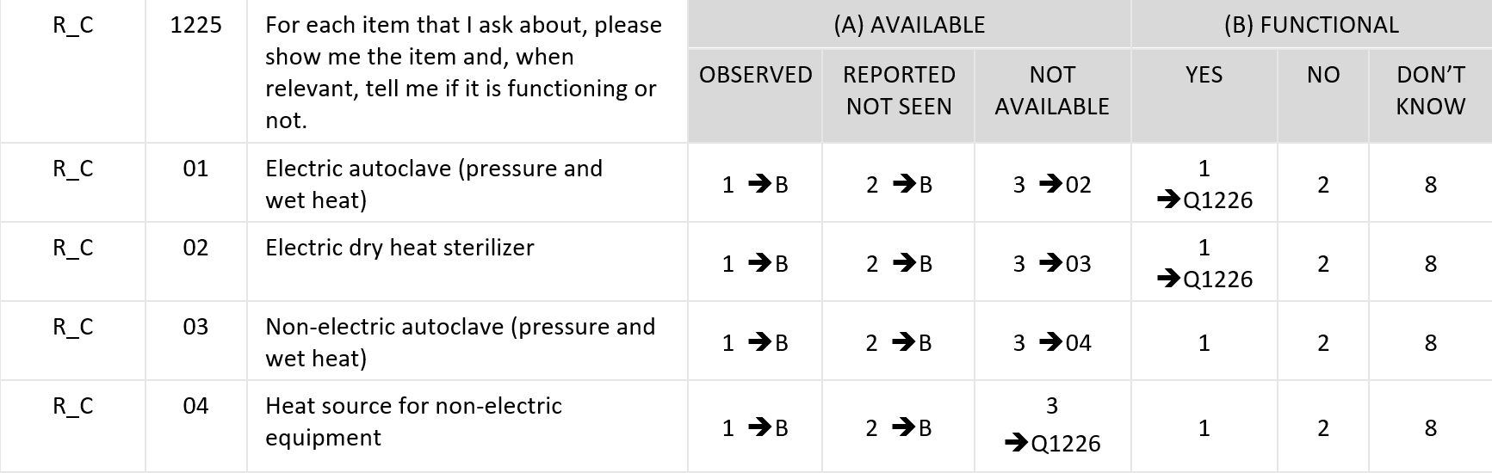
Equipment availability and functionality
Notes:
Question 1225 focuses on equipment, and questions about equipment are displayed as a response table with:
the list of equipment presented in rows; and
the availability and functionality presented in columns.

Slide 5
Equipment availability and functionality
Notes:
For “availability”, the interviewer has three response options:
“OBSERVED”;
“REPORTED, BUT NOT SEEN”; and
“NOT AVAILABLE”.
We also saw these options in the unit on site conditions.

Slide 6
Equipment availability and functionality
Notes:
For “functionality” the interviewer also has three response options:
“YES”;
“NO”; and
“DON’T KNOW”.

Slide 7
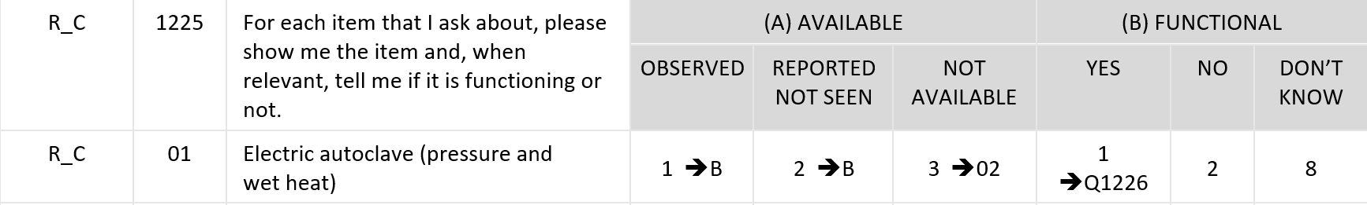
Equipment availability and functionality
“1” for “OBSERVED” or “2” for “REPORTED, NOT SEEN”
Notes:
The “availability” columns should be checked following the process we discussed in Unit 1.
However, if the equipment is available, instead of going to the next item, the skip patterns will take you to “functionality”.
Therefore, for the “1” “OBSERVED” or “2” “REPORTED, NOT SEEN” equipment, you will need to determine if the item is in working condition.

Slide 8
Equipment availability and functionality
“3” for “NOT AVAILABLE”
Verify that the staff is not reporting “NOT AVAILABLE” when the item is present but “non-functioning”.
Notes:
For the “3” “NOT AVAILABLE” option, the skip pattern will not make you ask for functionality.
If the item is “NOT AVAILABLE”, verify that the staff is not reporting “NOT AVAILABLE” when in fact the item is present but “non-functioning”.

Slide 9
Equipment availability and functionality
“1” for “YES”
Reported functionality is enough
Notes:
Now we are going to look into equipment functionality.
For the “OBSERVED” or “REPORTED, NOT SEEN” equipment, you will go to column B.
Select “1” for “YES” if the respondent tells you that the item is functioning. Although observed functioning is desired, it is usually not practical to ask the staff to start a generator or major laboratory equipment. So reported functionality is enough. Items that require batteries must have functional batteries to be marked as functional.

Slide 10
Equipment availability and functionality
“2” for “NO”
The program implication of having equipment that is not functional is different to that of not having equipment.
Notes:
Select “2” for “NO” if the respondent tells you that the item is not in working order.
If the item is available but is not functioning, it will be marked as “1” “OBSERVED” OR “2” “REPORTED, NOT SEEN” and as “NOT FUNCTIONAL”.
The program implication of having equipment that is not functional is different to that of not having equipment.

Slide 11
Equipment availability and functionality
“8” for “DON’T KNOW”
the respondent is not certain whether the item is in working condition
the data collector cannot verify whether it is functional
Notes:
Select “8” for “DON’T KNOW” if:
the respondent is not certain whether the item is in working condition; and
the data collector cannot verify whether it is functional.
For example, the place where the item is stored may be locked and cannot be accessed at the time of the survey.

Slide 12
You have now completed Unit 3.
In the next unit, we will look at data collection on availability of medicines and commodities.
First, try the practice exercises.
Notes:
You have now completed Unit 3.
In the next unit, we will look at data collection on availability of medicines and commodities.
First, try the practice exercises.

